Slide 1

Final Project Presentation
Topic: Technology Equipment Store
Instructed by: Piseth Sok
Presenter: Sokchea Leang
Subject: Website Development
Time: 1:00 pm to 4:00 pm

Slide 2

Content
PROBLEMS
SOLUTION
RESULT
TECHNOLOGIES
RECOMMENDATION

Slide 3

I. PROBLEM
Make my store become well-known
Feature for buying things online
Grow Online Business
Give Information Online

Slide 4

II. SOLUTION
Build a website and host it
Create Selling online Feature
Push Product Information into website

Slide 5
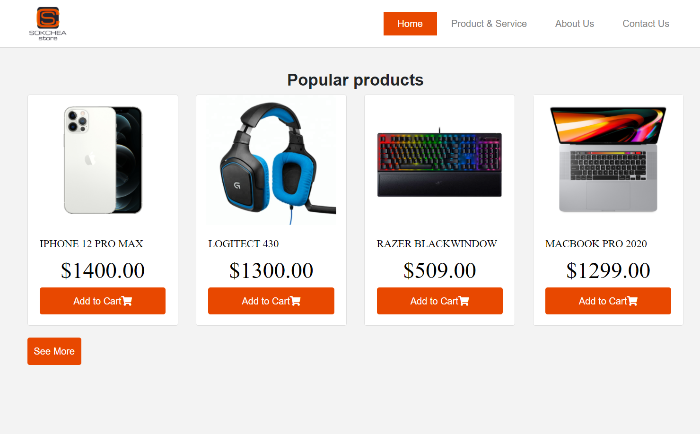
III. Result
List Product
Online Order

Slide 6




IV. TECHNOLOGIES
HTML,CSS
BOOTRAP
FONT AWESOME
JAVASCRIPT

Slide 7

V. RECOMMENDATION
Search Products
Product Details
Cart Page

Slide 8
<p>Thank You for paying attention</p>
ANY QUESTION?

